Slide 1

Computer Architecture
Project(GPU)
Students name:
Pooria Rahimi(99521289)
Deadline:1401/04/19 23:59:59

Slide 2
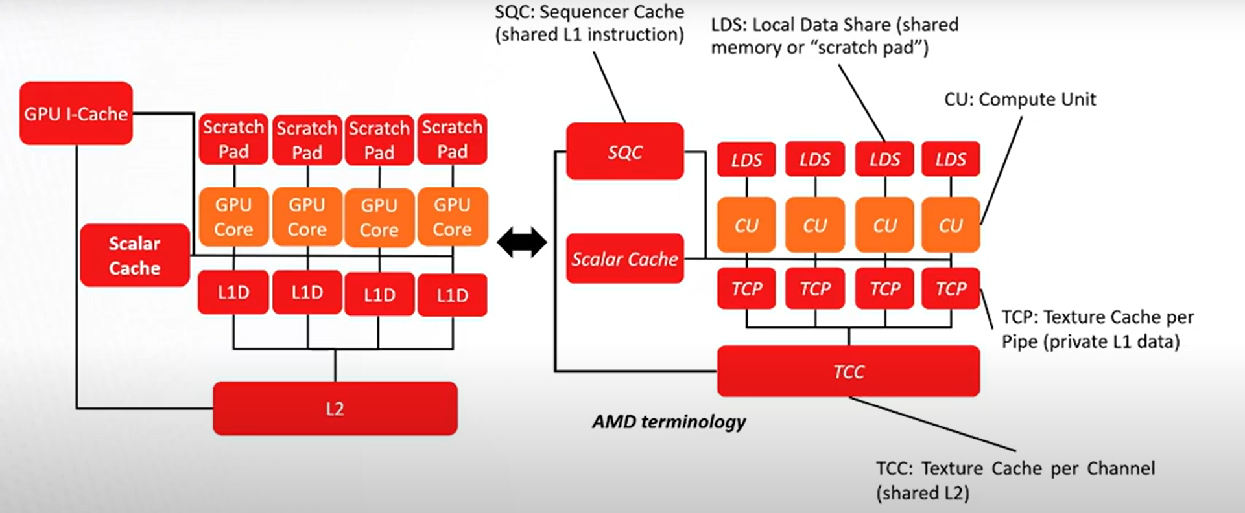
GPU Programming Model :
High-Level View of GPU:
in this implementation GPU cores are called as compute units(CU), SQC stands for sequencer cache, LDS stands for
Local Data share , …

Slide 3
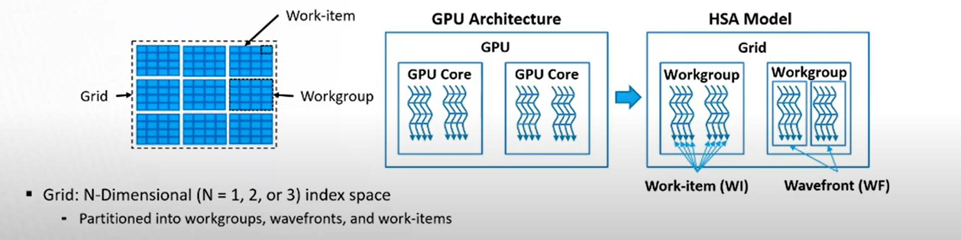
all of these components will be modeled in our Gem5 GPU!
In AMD model HSA ( Heterogenous Systems Architecture ) programming abstraction provides lightweight abstraction of the GPU hardware that capture basic OpenCL constructs! In this model we consider threads as single work item, a group of threads that execute together is called wavefront and a collection of wave fronts that execute together are known as work groups.
All threads in kernel would be called grid.
Wavefronts may also have scalar instructions (both memory and ALU mixed in with vector memory instructions). Wavefronts within a single workgroup must all be dispatched to the

Slide 4
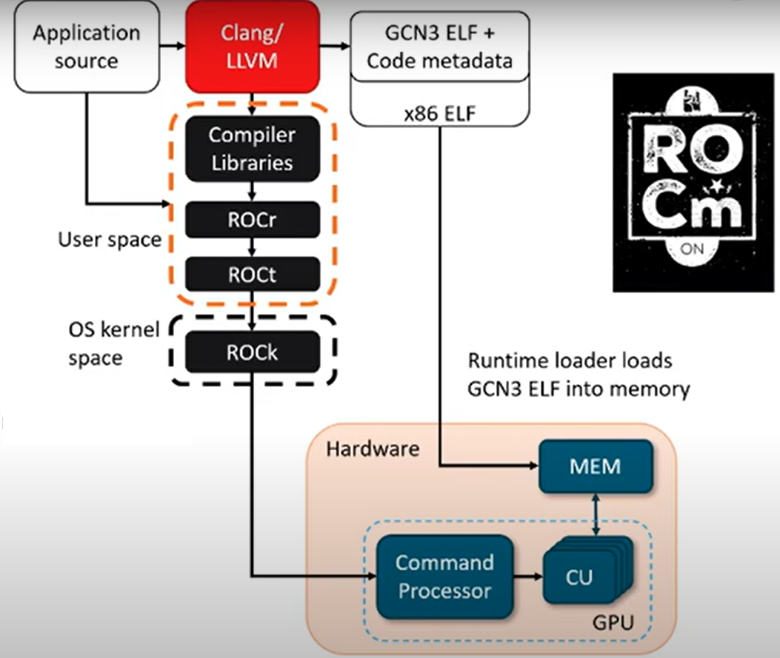
same CU together and there are various synchronization methods for communicating within wavefronts and workgroups.
GPU Hardware Software Interface:
ROCm is our software platform for high performance compute on GPUs which provides us clang LLVM-based HSA compiler for cpus and gpus, clang consists of apis and low level primitives for supporting the HSA standards, also it allows for single source CPU GPU applications written in c++. In general GPU is a Hardware-Software co-designed machine which directly executes GCN3 ISA. The command processor known as CP helps implementing the HSA standards, launching kernels , …. CP In conjunction with ISA and runtime software provides us application binary interface (ABI). these ABIs aid in the programmability of GPUs.

Slide 5
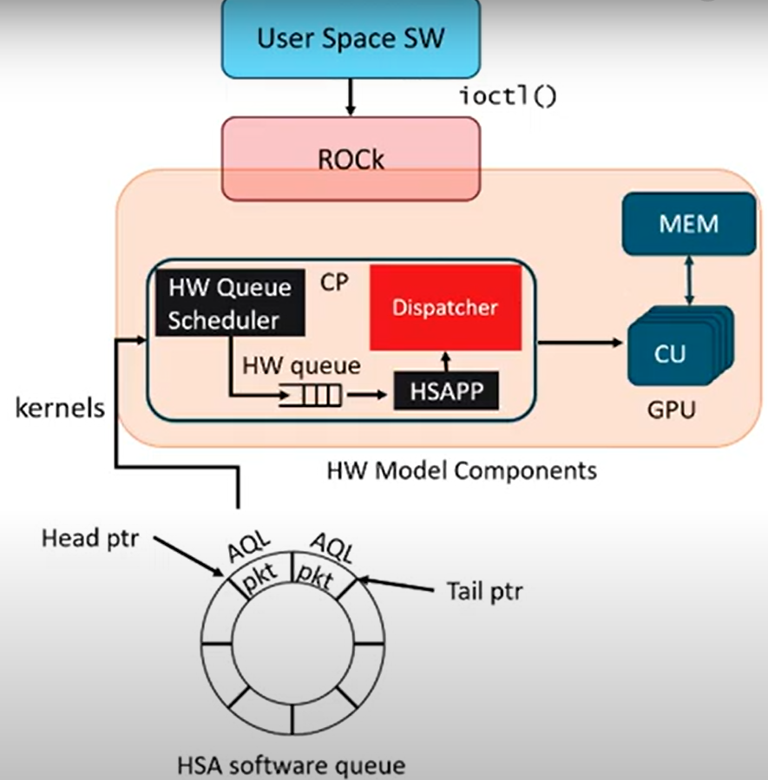
Kernel Launch Flow For a GPU designed by Gem5:
As we know, kernel launches the primary interface to the GPU and here we investigate a detailed view of the kernel launch flow, in this model hardware will dispatch lots of tasks as queue and CP responsibility is scheduling these tasks to be launched for GPU. Architected queuing language (AQL) provides a command interface for GPU. This packets include kernel details and its requirements such as number of work items, register file size, memory requirements and etc.

Slide 6
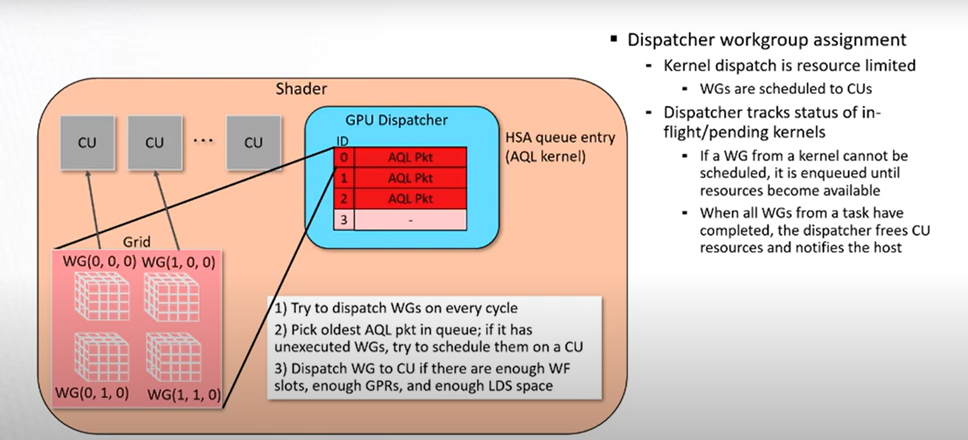
After the packet processor has parsed the packet, next step is dispatching workgroups to the computer units, if there are not enough resources dispatcher will track in-flight workgroups and launch the as soon as resources are freed. After dispatching all workgroups, CP will free resources and alert the hosts that the kernel has finished.
GPU ABI initialization:
ABI
Interface between the application binary and other components
Function call convention, location of special values, etc.

Slide 7
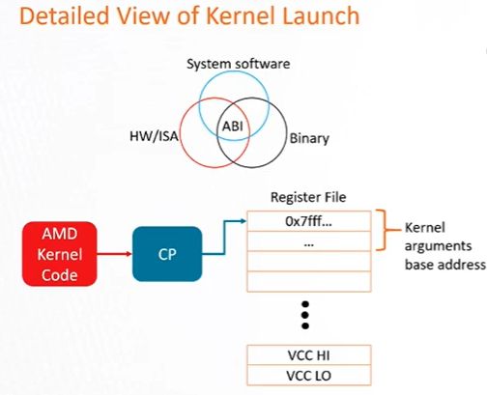
ABI state primarily maintained in register file
Some state maintained in the WF context for simplicity
CP responsible for initializing register file state
Extracts metadata from code object
Initializes both scalar and vector registers
Kernel argument base address, vector condition codes(VCC), etc.

Slide 8
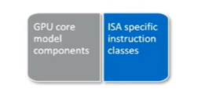
ISA Description/Microarchitecture Separation:
GPUStaticlnst and GPUDynlnst
Archtecture-specific code in src/arch/
Define API for instruction execution
Implemented by ISA-specific instruction
GPUExecContext and GPUISA
Define API for accessing ISA state
Object-oriented design
Base classes define the API
Configuration system instantiates ISA-specific objects
The ISA implementation handles instruction decoding operand assignment and manages various is a specific state most importly the execute method for GPU instructions must be implemented by each instruction with their specific instructions
Execution semantics
The GPU execution context and instruction classes define the API used by the core model to interact with the ice implementation this allows a single GPU core model designed to be extensible to other ISAs

Slide 9
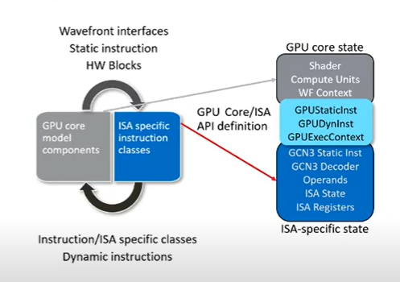
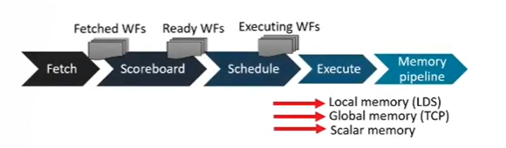
Core microarchitectural models:
GPU CORE Timing
conceptual timing stages
Execute-in-execute philosophy

Slide 10
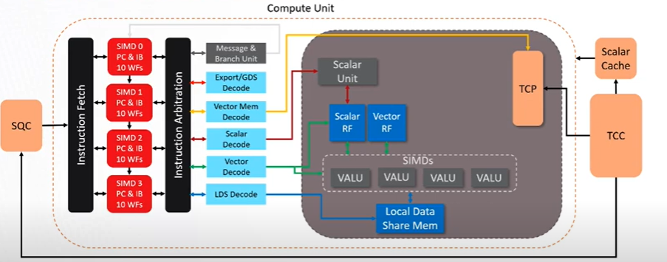
GPU Core Based on GCN Architecture:
GPU Core MODULE INTERNALS:
Shared and private structures
compute unit
Four 16-wide SIMD units
SIMD host WFs

Slide 11
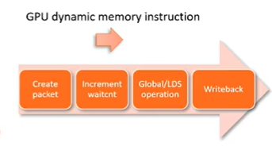
Private resources to each SIMD:
Instruction buffering
Registers
Vector ALUs
Shared resources:
Fetch and decode
TCP
LDS
GPU Memory Timing:

Slide 12
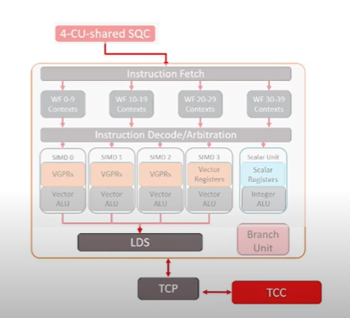
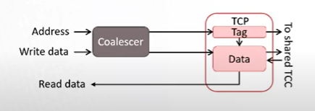
Vector Memory Execution:
LDS
User-managed address space
Scratchpad for WFs in workgroup
Used for data sharing and synchronization within workgroup
Cleared when workgroup completes

Slide 13
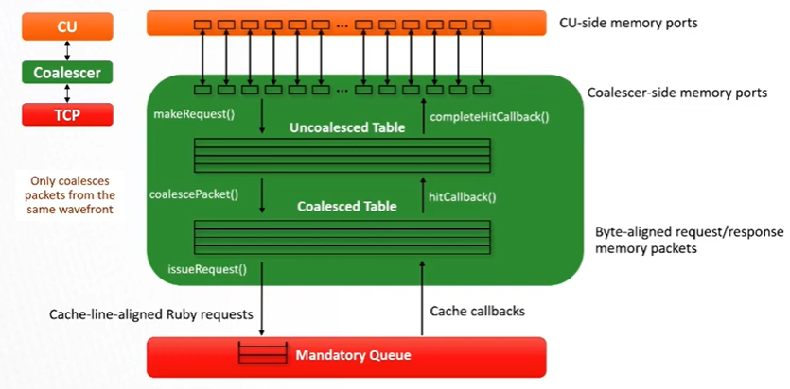
CU Memory Interface:
GPU memory coalescing critical for performance

Slide 14
What Does a GPU Do?
The graphics processing unit, or GPU, has become one of the most important types of computing technology, both for personal and business computing. Designed for parallel processing, the GPU is used in a wide range of applications, including graphics and video rendering. Although they’re best known for their capabilities in gaming, GPUs are becoming more popular for use in creative production and artificial intelligence (AI).
GPUs were originally designed to accelerate the rendering of 3D graphics. Over time, they became more flexible and programmable, enhancing their capabilities. This allowed graphics programmers to create more interesting visual effects and realistic scenes with advanced lighting and shadowing techniques. Other developers also began to tap the power of GPUs to dramatically accelerate additional workloads in high performance computing (HPC), deep learning, and more.
What Are GPUs Used For?
Two decades ago, GPUs were used primarily to accelerate real-time 3D graphics applications, such as games. However, as the 21st century began, computer scientists realized that GPUs had the potential to solve some of the world’s most difficult computing problems.
This realization gave rise to the general purpose GPU era. Now, graphics technology is applied more extensively to an increasingly wide set of problems. Today’s GPUs are more programmable than ever before, affording them the flexibility to accelerate a broad range of applications that go well beyond traditional graphics rendering.

Slide 15
GPUs for Gaming
Video games have become more computationally intensive, with hyperrealistic graphics and vast, complicated in-game worlds. With advanced display technologies, such as 4K screens and high refresh rates, along with the rise of virtual reality gaming, demands on graphics processing are growing fast. GPUs are capable of rendering graphics in both 2D and 3D. With better graphics performance, games can be played at higher resolution, at faster frame rates, or both.
GPUs for Video Editing and Content Creation
For years, video editors, graphic designers, and other creative professionals have struggled with long rendering times that tied up computing resources and stifled creative flow. Now, the parallel processing offered by GPUs makes it faster and easier to render video and graphics in higher-definition formats.
When it comes to performance, Intel provides no-compromise solutions for both the CPU and GPU. With Intel® Iris® Xe graphics, gamers and content creators can now get even better performance and new capabilities. Optimized for 11th Gen Intel® Core™ processors and perfect for Ultra-thin and light laptops, Intel® Iris® Xe graphics come integrated with the processor. Select laptops also include , Intel’s first discrete graphics product in 20 years.
Intel® Iris® Xe MAX was designed to provide advanced graphics performance and media capabilities, as well as enjoy seamless, immersive gameplay anywhere in 1080p. All while on a sleek lightweight laptop. Additionally, by combing 11th Gen Intel® Core™ processors, Iris® Xe MAX discrete graphics, and , you can experience 1.4X AI¹ performance and 2X better performance encoding single stream videos² than with a 3rd party discrete graphics.

Slide 16
GPU for Machine Learning
Some of the most exciting applications for GPU technology involve AI and machine learning. Because GPUs incorporate an extraordinary amount of computational capability, they can deliver incredible acceleration in workloads that take advantage of the highly parallel nature of GPUs, such as image recognition. Many of today’s deep learning technologies rely on GPUs working in conjunction with CPUs.
GPU vs. CPU
GPUs are fairly similar to CPU architectures. However, CPUs are used to respond to and process the basic instructions that drive a computer, while GPUs are designed specifically to quickly render high-resolution images and video. Essentially, CPUs are responsible for interpreting most of a computer's commands, while GPUs focus on graphics rendering.
In general, a GPU is designed for data-parallelism and applying the same instruction to multiple data-items (SIMD). A CPU is designed for task-parallelism and doing different operations.
Both are also differentiated by the number of cores. The core is essentially the processor within the processor. Most CPU cores are numbered between four and eight, though some have up to 32 cores. Each core can process its own tasks, or threads. Because some processors have multithreading capability -- in which the core is divided virtually, allowing a single core to process two threads -- the number of threads can be much higher than the number of cores. This can be useful in video editing and transcoding. CPUs can run two threads (independent instructions) per core (the independent processor unit).

Slide 17
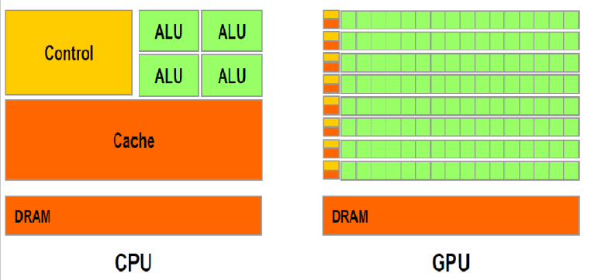
A GPU core can have four to 10 threads per core.
A GPU is able to render images more quickly than a CPU because of its parallel-processing architecture, which allows it to perform multiple calculations at the same time. A single CPU does not have this capability, although multicore processors can perform calculations in parallel by combining more than one CPU onto the same chip.
A CPU also has a higher clock speed, meaning it can perform an individual calculation faster than a GPU, so it is often better equipped to handle basic computing tasks.

